Slide 1
2018 CTMA

Slide 2
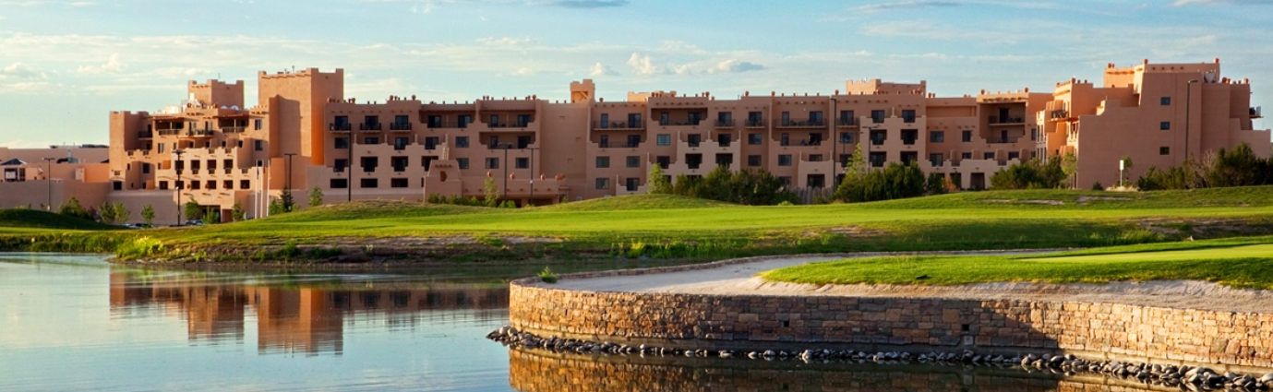
Hilton santa fe buffalo thunder
May 21 – 24, 2018

Slide 3
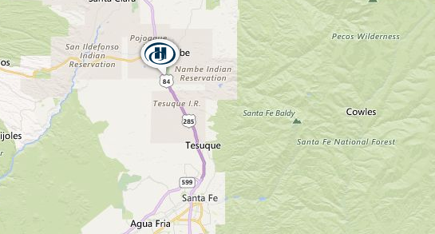
Located 9 Miles North of Santa fe
& 75 miles north of Albuquerque

