Slide 1
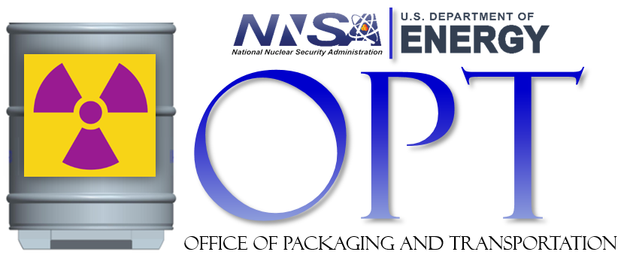
NNSA Office of Packaging and Transportation, NA-531
Chad E. Thompson
Package Certification Engineer

Slide 2
Agenda
NNSA OPT Parent Organization
NNSA OPT Functional Areas
NNSA OPT Updates
Certified, or Compliant Packages
SNL Designed Packages
SRNL Designed Packages
Y-12 Designed Packages
Noncompliant Risk Based Packages
Key Takeaways

Slide 3
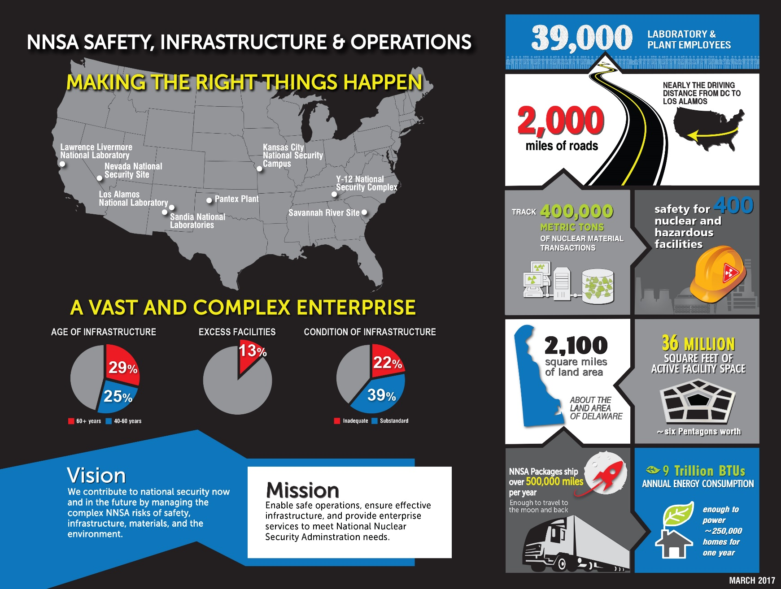
NNSA Parent Organization, NA-50

Slide 4
NNSA OPT Functional Areas
NNSA Certifying Official
Certify NNSA fissile and Type B radioactive material packages for offsite shipment.
Authorize NNSA to ship noncompliant packages and/or weapon assemblies.
Approve site-specific packaging and transportation (P&T) quality assurance program plans and site-specific packing/unpacking procedures for NNSA certified packages.
Approve Authorized Users of NNSA certified and approved packages.
Conduct periodic oversight of NNSA certified package user sites.
Provide technical assistance to NNSA HQ program offices, Field Offices and contractors on Title 10 Code of Federal Regulations (10 CFR), 49 CFR and DOE order P&T requirements.

Slide 5
NNSA OPT Updates
New Leadership - NNSA OPT Director is Kathy Schwendenman
We are making a concerted effort to foster new relationships through outreach to the NNSA sites and fellow program offices.
Partnering with DOE Environmental Management (EM) OPT, EM-4.24 on numerous initiatives.
Packaging Program Management has been transferred to the NNSA Office of Infrastructure Operations & Modernization, NA-522
Ahmad Al-Daouk remains the NNSA CO at this time.

Slide 6
Certified, or Compliant Packages
10 CFR 71 only applies to fissile, or Type B quantities of radioactive material
Certified package means the package has demonstrated compliance with all applicable requirements of 10 CFR 71. NNSA issues OTCs for certified packages.
10 CFR 71 specifies test conditions for normal and accident transportation environments
Non-fissile, less than Type B (Type A, limited quantity, etc.) packages are governed by the DOT Hazardous Materials Regulations (49 CFR Parts 100-185) and do not need to be reviewed and approved by a competent authority
OTCs for Packages Meeting 10 CFR 71
Type B | Type B(U), or Type B(M)
Type B and Fissile | Type B(U)F or Type B(M)F
Type A and Fissile | Type AF

Slide 7
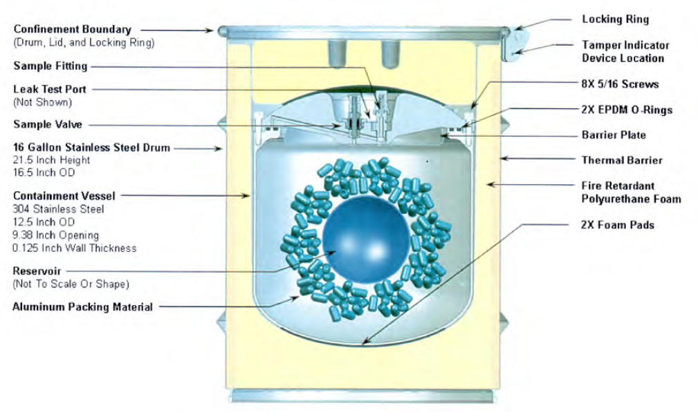
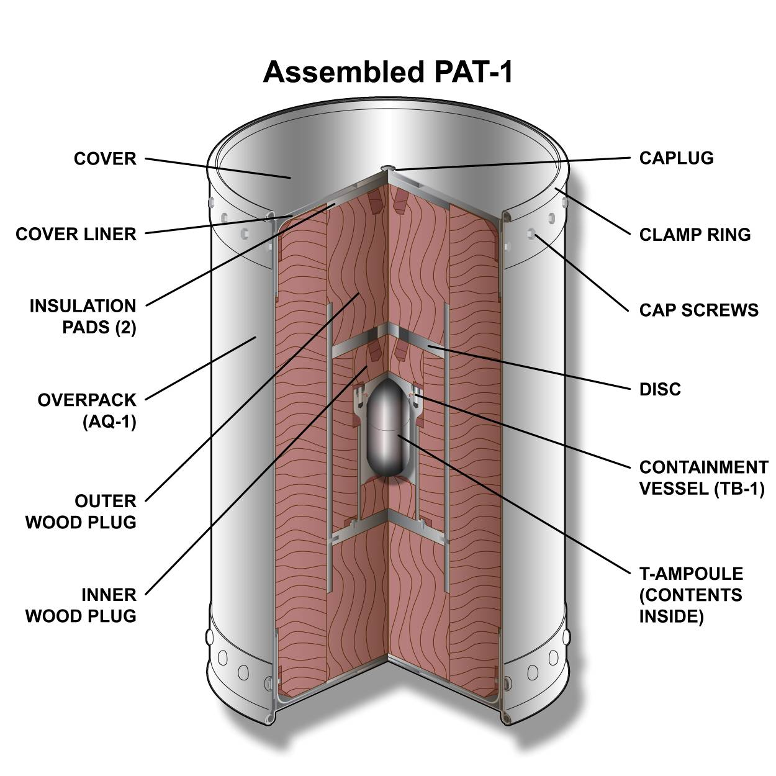
SNL Designed Packages
H1616 Tritium Containers (most frequently used package in the complex)*
PAT-1 (container certified for air transport of plutonium)
AWG711 (concept phase only, for air transport of plutonium)
*The H1616 is very small, only 21 inches tall and 150 lbs
The PAT-1 is large, nearly five feet tall

Slide 8
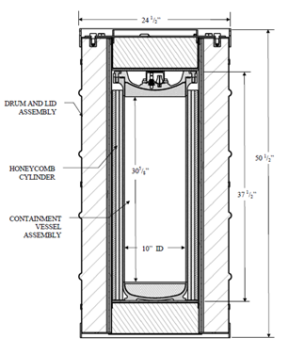
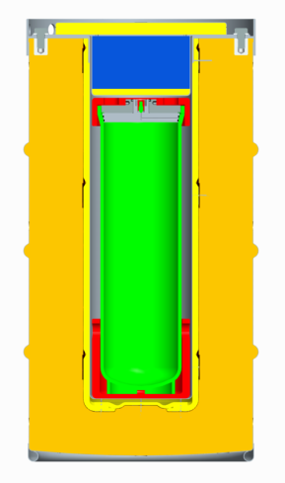
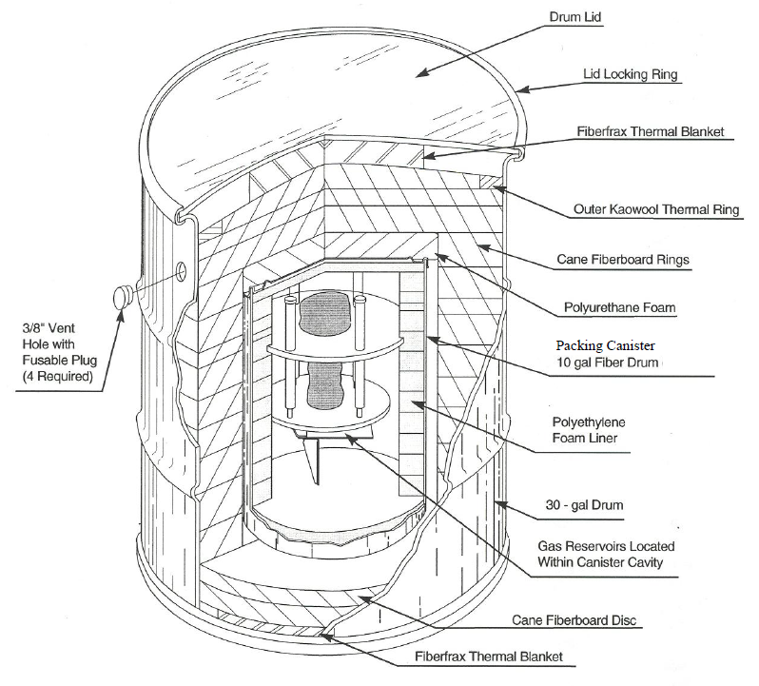
SRNL Designed Packages
Bulk Tritium Shipping Package (BTSP)
SR-101 Reservoir Package
9977/H1700

Slide 9
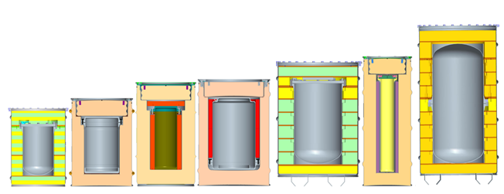
Y-12 Designed Packages
These are all certified Type B(U)F containers
The DT containers ship primarily CSAs, and HEU metal
The DPP-2 ships a variety of fissile assemblies
The ES-2100 and ES-3100 ship HEU
DT-20
19” dia
40” tall
MD-2
17” dia
24” tall
DT-23
18” dia
26” tall
ES-2100
8” dia
20” tall
DPP-2
12” dia
17” tall
DT-22
13” dia
17” tall

Slide 10
Various Others
Model FL (pits)
435-B Shipping Cask (NA-20 sealed sources)*
380-B Shipping Cask (NA-20 sealed sources)*
*Supports the Off-Site Source Recovery Program (OSRP)

Slide 11
Noncompliant Risk Based Packages
NNSA also ships packages that have not, or cannot demonstrate compliance with either the 10 CFR 71 requirements, or the DOT Hazardous Materials Regulations.
These packages are regulated by DOE O 461.1C, and evaluated by the risk the shipment presents to the public, worker, and environment.
Offsite Transportation Authorizations (OTAs), or Offsite Transportation Directions (OTDs), are issued for risk based packages.
OTAs and OTDs are usually issued for weapon assemblies, but may also be issued for drum type packages.
Non-compliant, Risk Based Packages
OTA | OTD
Non-fissile, Less than Type B | Fissile, or Type B

Slide 12
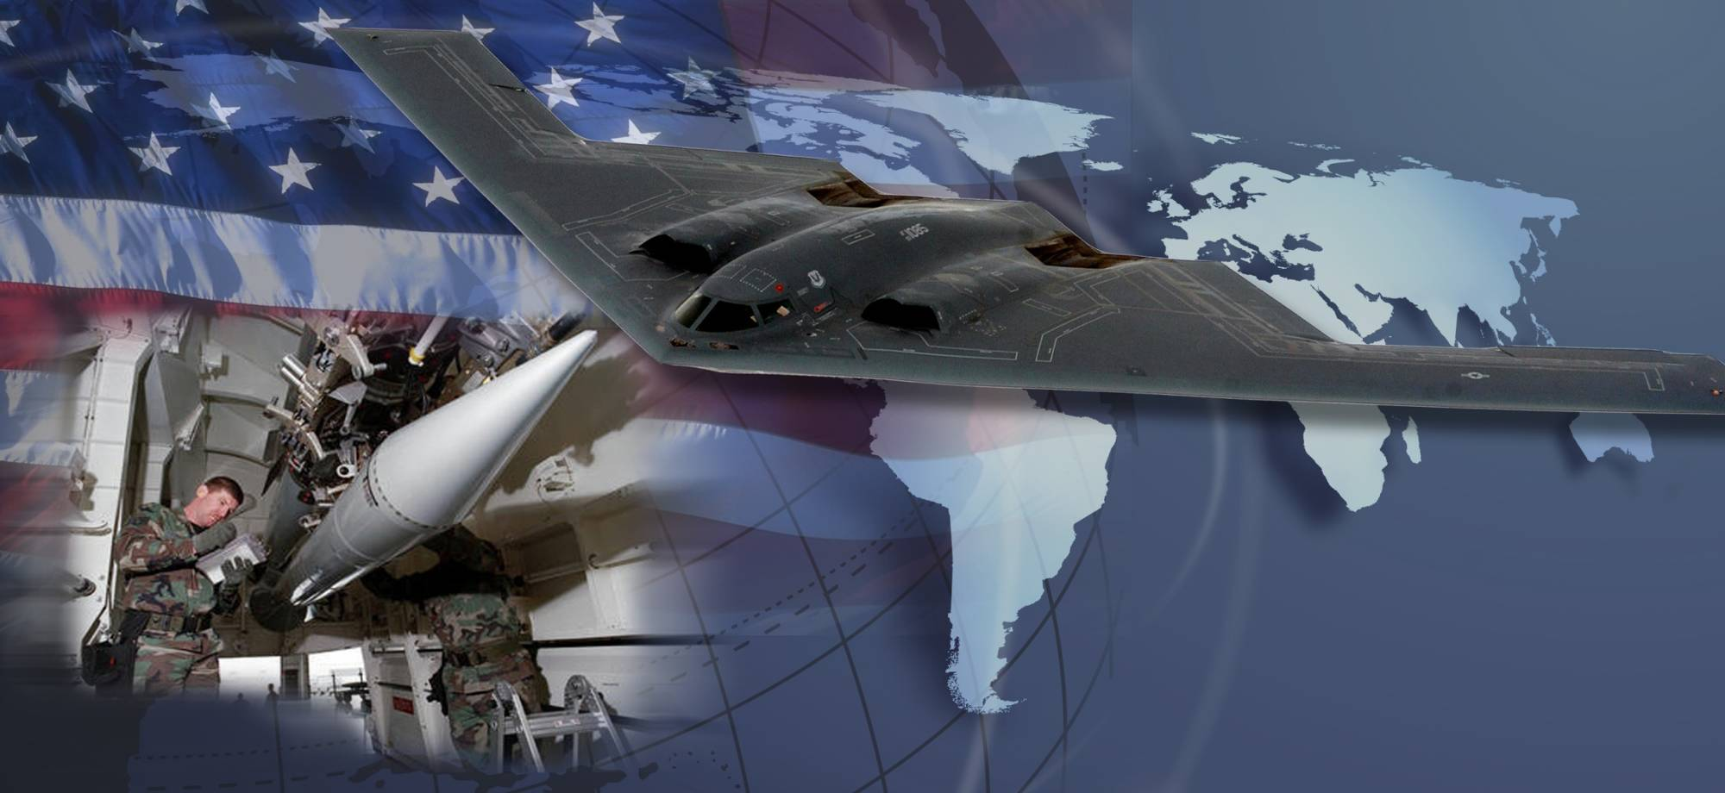
Key Takeaways
NNSA OPT Parent Organization Link
NNSA OPT Functional Areas
Certified, or Compliant Packages
OTA and OTD for noncompliant Risk Based Packages

Slide 13
Thank you for your time.

