Slide 1
A Hazmat Transportation Regulatory Update
Presented by Merrie Schilperoort, Atkins

Slide 2
DOT Civil Penalty Revisions FR Wednesday, April 19, 2017 (HM-258D) Applies to violations assessed on or after August 1, 2016

Slide 3
DOT Civil Penalty Revisions 49 CFR Part 107 and 171.1
A knowing violation of the Federal hazardous material law is liable for a civil penalty of not more than $78,376 for each violation (previously $77,114)
Except the maximum is $182,877 if the violation results in death, serious illness, or severe injury (previously $179,933)

Slide 4
DOT Civil Penalty Revisions 49 CFR Part 107 and 171.1
There is no minimum civil penalty except for a minimum civil penalty of $471 for violations relating to training. (Previously $463)
Subsequent annual adjustments for inflation beginning in 2017.

Slide 5
DOT Miscellaneous Amendments FR Thursday, June 2, 2016 (HM-218H) Effective Date July 5, 2016

Slide 6
HM-218H Highlights
Removed packing group (PG) II designation from the hazardous materials table for certain self-reactive substances, organic peroxides, and explosives

Slide 7
HM-218H Highlights
Require that emergency phone numbers be displayed on shipping papers numerically
Amend packaging instructions for certain shipments of nitric acid

Slide 8
DOT Changes to Harmonize with International Rules FR Thursday, March 30, 2017 (HM-215N) Delayed Compliance Date January 1, 2018

Slide 9
HM-215N Highlights
Definitions – 171.8
Added:
Design Life
SAPT (Self-accelerated Polymerization temperature)
Service Life
Amended:
Aerosol – clarifying that it is an article
Large salvage packaging
UN tube

Slide 10
HM-215N Highlights
Cylinders
Lots of work to allow certain Canadian specification cylinders to be shipped to, from and within the US.

Slide 11
HM-215N Highlights
Hazmat Table
Added a few proper shipping names
Engines…
Polymerizing Substance…
Revised many proper shipping names and references to special provisions
Be sure to use the latest edition of the hazmat table for your shipments

Slide 12
HM-215N Highlights
Hazmat Table
If you ship Uranium Hexafluoride:
In addition to being radioactive and corrosive, this final rule adds 6.1 Toxic. For < 0.1 kg, 6.1 is the PRIMARY hazard.
This compelled placarding for both subsidiary hazards when shipping greater than 454 kg of UF6

Slide 13
HM-215N Highlights
Marine Pollutants:
Five new substances added
Special Provisions:
Twenty-two special provisions were either added or revised

Slide 14
HM-215N Highlights
172.407 Label Specifications
Minimum size of solid line forming the border was to go into effect on January 1, 2017 (2mm)
Date of compliance for domestic transportation is now December 31, 2018

Slide 15
HM-215N Highlights
New Lithium Battery label
Mandatory compliance December 31, 2018

Slide 16
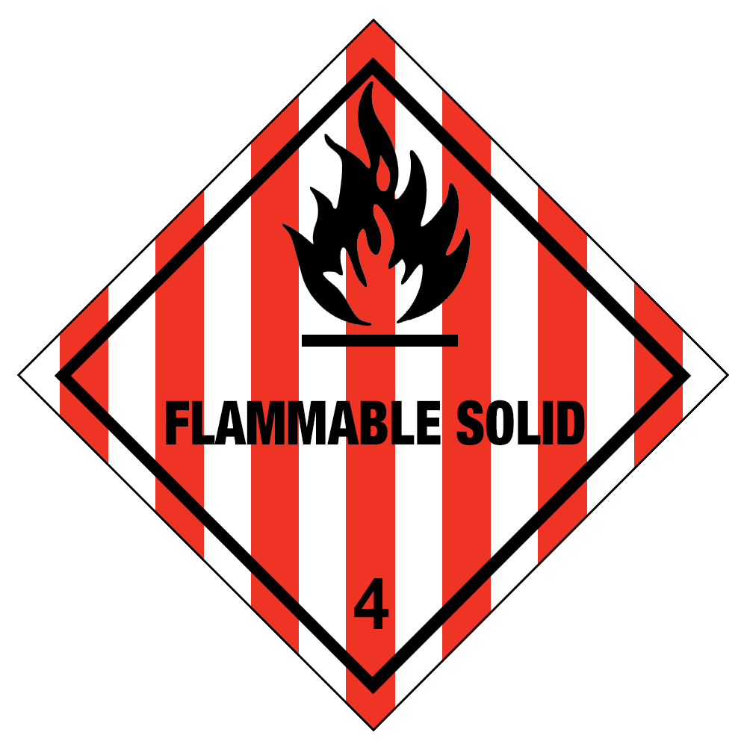
HM-215N Highlights
173.124 Class 4 Definitions
Added Polymerizing Materials to the definition of Division 4.1 Flammable Solid

Slide 17
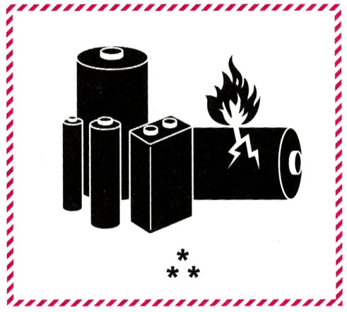
HM-215N Highlights
173.185 Lithium Batteries
New Lithium Battery Marking
Mandatory compliance
December 31, 2018

Slide 18
HM-215N Highlights
173.310 Exceptions for radiation detectors
If you ship Radiation Detectors:
Increased design pressure and capacity
Added two new paragraphs
(e) document on the shipping paper the section being used
(f) under certain conditions detectors may be unregulated

Slide 19
EPA Hazardous Waste Generator Improvements Rule FR Monday, November 28, 2016 Effective Date May 30, 2017

Slide 20
EPA Final Rule Highlights
Significant reorganization of the regulations (5 tables added to assist)
Hazardous Waste Determinations and Guidance
Hazardous Waste Counting and Examples

Slide 21
EPA Final Rule Highlights
Replacing the term Conditionally Exempt Small Quantity Generator (CESQG) with Very Small Quantity Generator (VSQG)
Emergency Planning
Marking and Labeling changes

Slide 22
EPA Container Markings
Two new marking requirements:
Hazard of the contents
Hazardous Waste Numbers (EPA waste codes)

Slide 23
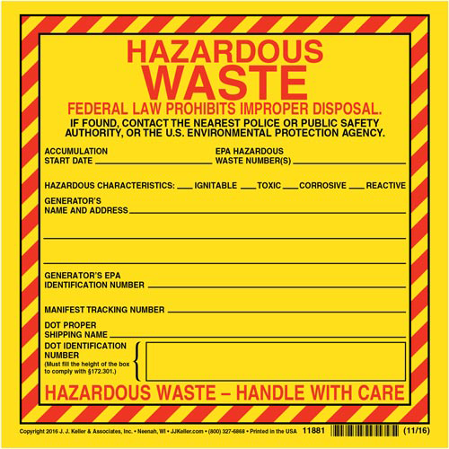
EPA Container Markings

Slide 24
Thank you
If you’d like to find out more visit: www.atkinsglobal.com/energytraining

