Slide 1
Shipping to WIPP
Travis R. Myers
5/24/17

Slide 2

Resuming Shipments to WIPP
Site | Projected Shipments
Idaho Site | 61
Oak Ridge Site | 24
Savannah River Site | 8
Waste Control Specialists | 11
Los Alamos Site | 24
TOTAL | 128
* Estimated WIPP TRU Shipments - February 2017 through January 2018
The Department of Energy (DOE) developed estimates for the resumption of shipments of transuranic (TRU) waste to the Waste Isolation Pilot Plant (WIPP)

Slide 3
Resuming Shipments to WIPP (cont.)
Carlsbad Field Office Manager Todd Shrader stated:
  “We are pleased that WIPP is once again emplacing waste. The suspension of disposal operations has posed challenges at DOE sites, with backlogs of TRU waste building up. Resuming shipments from generator sites is important to support cleanup and ongoing missions at those sites. We look forward to doing that as soon and as safely as possible.”

Slide 4
Generator Sites
Waste destined for WIPP must meet readiness to load and ship TRU containers; and must meet the updated Documented Safety Analysis requirements
Fluor Idaho, LLC, on behalf of the U.S. Department of Energy (DOE) supports the Department’s cleanup mission at the Idaho Site under the Idaho Cleanup Project Core Contract (ICP Core)

Slide 5
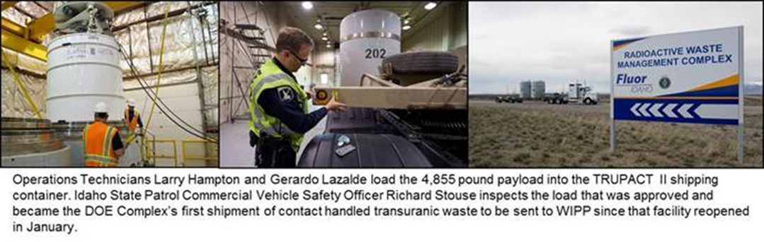
Idaho Cleanup Project Core
Fluor Idaho was successful in releasing their first WIPP shipment on April 6, 2017

Slide 6
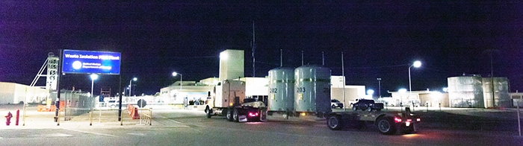
APRIL 10, 2017
CARLSBAD, N.M. – EM’s Waste Isolation Pilot Plant (WIPP) announced receipt of its first shipment of transuranic (TRU) waste since WIPP reopened in January. The shipment from Idaho is an important milestone for WIPP and for DOE host communities…

Slide 7
The Roadway to Success
Surveillances and Assessments
January- Generator Site Technical Review (GSTR)
  The GSTR is one of several new requirements that must be successfully completed to regain certification authority for TRU waste shipments to WIPP
March- Coordinated with WIPP for completing a TRUPACT Mock Shipment
  Advanced Mixed Waste Treatment Facility
  Over the road

Slide 8

Mock Shipment- AMWTP
Conducted a Management Assessment (MA) for transportation activities in preparation for CH-TRU waste shipments to the Waste Isolation Pilot Plant (WIPP).
  The dry run initiated on March 6, 2017 and involved participation from the Idaho State Police, Carlsbad Field Office (CBFO), CAST Transportation LLC, Packaging and Transportation (P&T), Operations, and RadCon
  The mock shipment was delayed for two days due to weather and was released on March 8, 2017.
    The exercise delay was typical for spring weather and provided good preparation for loaded TRUPACT-II shipping delays

Slide 9
Mock Shipment- AMWTP (Cont.)
The following assessment focus areas were reviewed:
  Work Control / NRC packaging user- DOE O 460.1C
  Procedures / Operations
  HazMat Communications, Marking and Labeling, and Shipping Papers
  Coordination and Notifications
  Idaho State Police (ISP)- CVSA VI
  Radiological Surveys
  Individual Training, including TRANSCOM for Shippers
  Future Logistics- e-mail distribution list, badging, WDS, ATLAS, other items

Slide 10
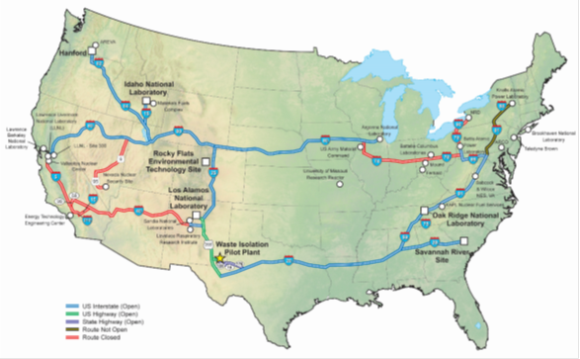
Mock Shipment- Over the Road

Slide 11
Mock Shipment- Over the Road (Cont.)
The Waste Isolation Pilot Plant (WIPP) transportation program traveled WIPP transportation corridors to support state-sponsored road shows to give the public an opportunity to learn about shipping waste packages to the facility

Slide 12
WIPP Shipping Progress
Idaho Site schedule- April one shipment per week and two shipments per week in May
  April completed 4 shipments
  May will complete ~9 shipments
Cast and Visionary continue to provide carrier services
Interfaces with the Idaho State Police, Nuclear Waste Partnership, Carlsbad Field Office, and TRANSCOM have functioned smoothly

Slide 13
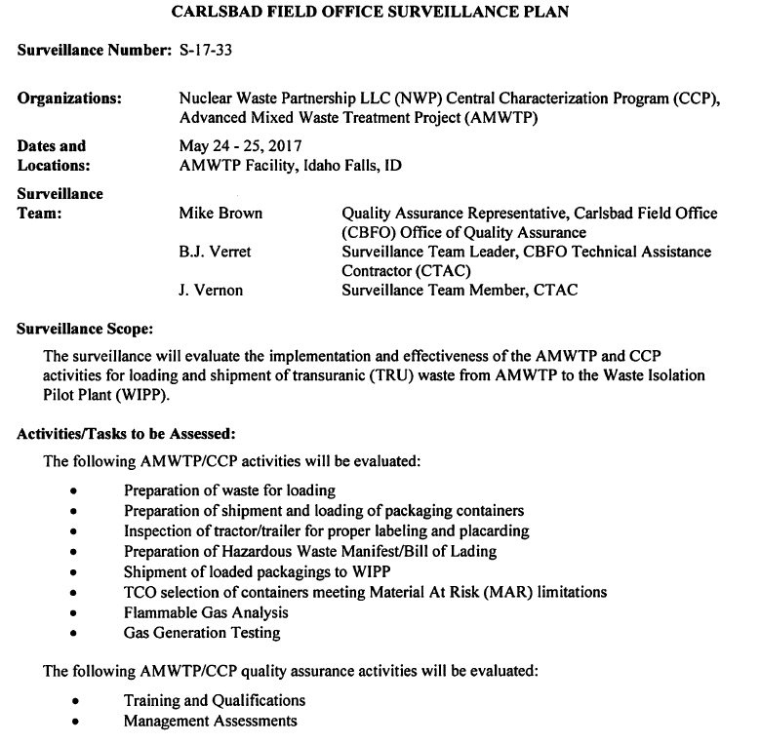
CBFO Surveillance- Week of CTMA!

Slide 14
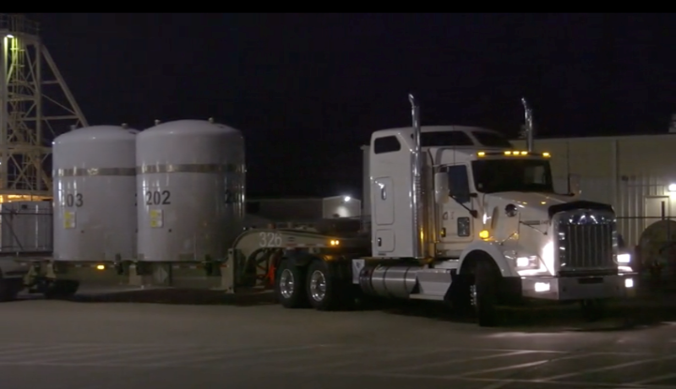
Progress Across the Complex
Questions about the Idaho shipping campaign will be deferred to the conclusion of a second presentation
Next we will hear about Las Alamos National Laboratory
A truck from Idaho arrived at the Waste Isolation Pilot Plant in the night

