Slide 1
The Off-Site Source Recovery Program Capabilities in Recovering Sealed Sources – 17599
CTMA, May 23-26, 2017
James (Jim) Matzke

Slide 2
Background on OSRP Recoveries
OSRP’s mission – 16 years of recovering excess, unwanted, abandoned, and orphaned radioactive sealed sources in the interest of national security and public health and safety
OSRP is sponsored by the NNSA Office of Global Material Security’s Office of Radiological Security
Recovery of TRU, US origin, defense-related sources (Pu-239, Pu-238, Am-241, Cf-252, Cm-244) and non-TRU not commercially disposable sources (Sr-90, Cs-137, Co-60, Ir-192, Ra-226)

Slide 3
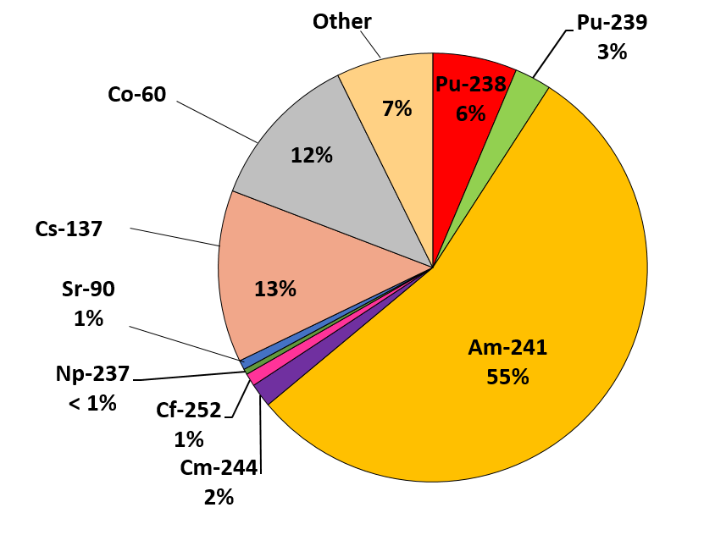
Sealed Sources Recovered by Isotope
67% of the sources recovered are TRU
26% of the sources recovered are high-activity beta-gamma

Slide 4
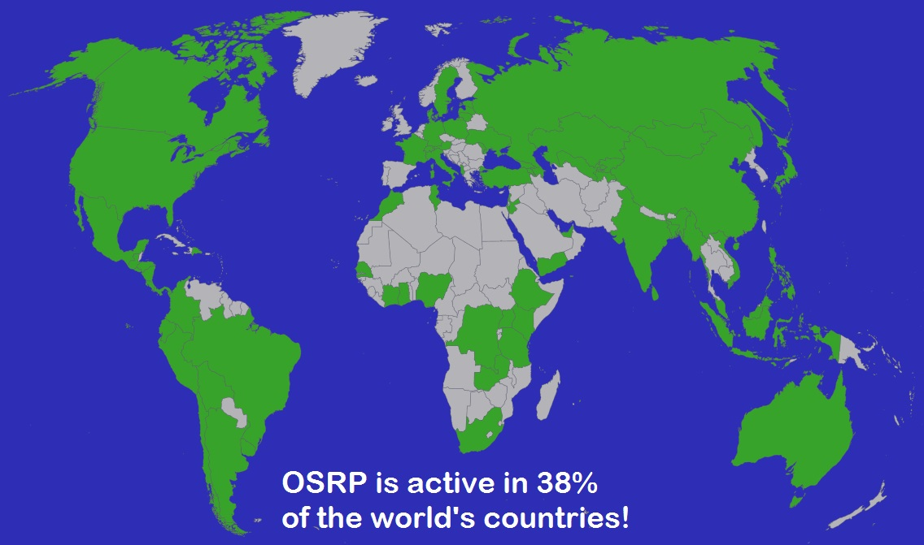
OSRP Operations Worldwide
Source Recovery, Consultancy, Training

Slide 5
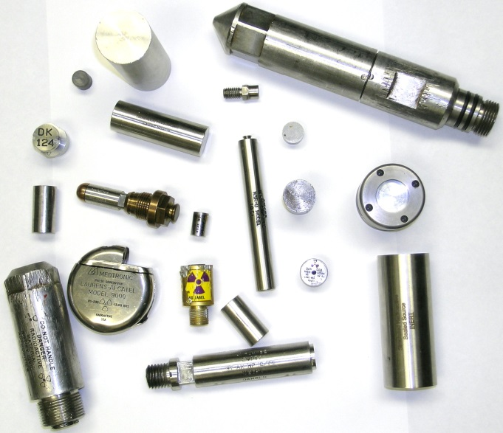
Source Registration
OSRP helps licensees register and qualify sources for recovery
Globally, over 3000 sites have registered more than 70,000 sources
OSRP has recovered nearly 38,500 disused and unwanted sources
Register sources at osrp.lanl.gov

Slide 6
Types of Source Recoveries
Single site recovery – typically one site with a large number of sources
Multi-site round-up recovery – typically several licensees with less sources per site
Self-ship recoveries – licensee assisted shipping of few sources

Slide 7
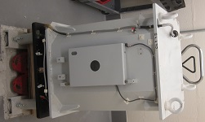
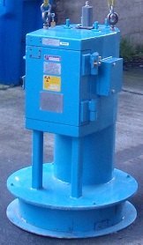
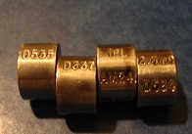
Types of Licensees and Source Applications
Licensees: private industry, universities, hospitals, DOE labs, and other governmental sites
Applications: industrial radiological devices (moisture-density, thickness gauges etc.), medical devices (blood irradiators, radiotherapy), research, nuclear power plants, etc.
IBL 437 C
JLS Mark 1
IPL Am-241 XFB-3

Slide 8
Source Recovery Sites in FY16

Slide 9
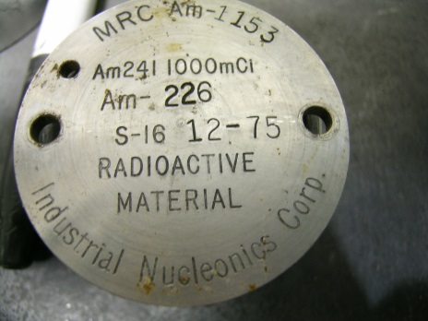
Steps Towards TRU Source Eligibility
Register excess and “in-use” sources at osrp.lanl.gov
In most cases OSRP covers the cost for source recovery
TRU sources that have US origin and satisfy WIPP Acceptable Knowledge (AK) criteria for source information
Drums packaged for WIPP must have a decayed activity greater than 100 nCi/g for TRU isotopes and a contact dose rate <200 mrem/h
OSRP performs an average of 40-50 recoveries per FY

Slide 10
Type A Packaging Used for WIPP Source Disposal
Component | S100 Drum | S300 Drum | 12”Pipe Overpack
Standard 55 gal. drum & rigid liner | Yes | Yes | Yes
Pipe Component Diameter | 6” | 12” | 12”
Internal Shield Insert | Yes | Yes | No
Shield Outside Pipe Component (Neutron Shield) | Yes | No | No
Outer Fiberboard Pkg | No | Yes | Yes
Main Uses | Neutron Sources, Small Volume, Less Sources | Type A Fissile packaging, Special Form USA/9329/AF-96 | Alpha or Shielded Neutron Sources, Larger Volume, More Sources

Slide 11
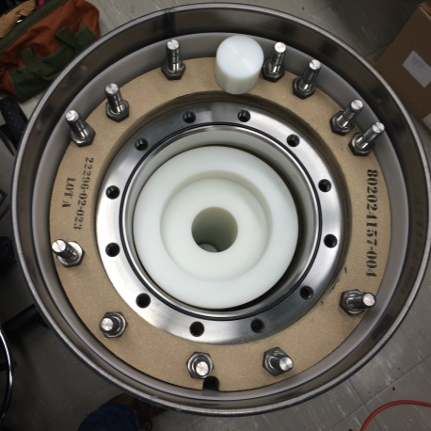
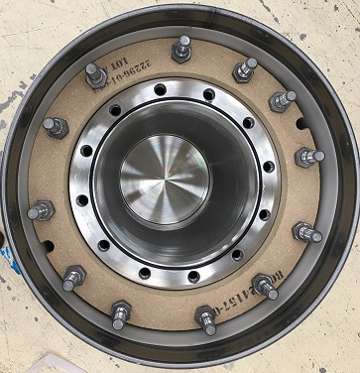
Drums Used for TRU Source Packaging
S100
S300
12” POC

Slide 12
Packaging and Shipment of TRU Sources
OSRP has authorized shippers to facilitate shipment from licensees
Different contact handled packaging configurations determined by:
Total source activity
Dose rate
Source dimensions
Shipments follow DOT regulations 49 CFR:
Normal form sources over A₂ limit are encapsulated in Special Form Capsules (SFCs)
Special form sources under A₁ limit

Slide 13
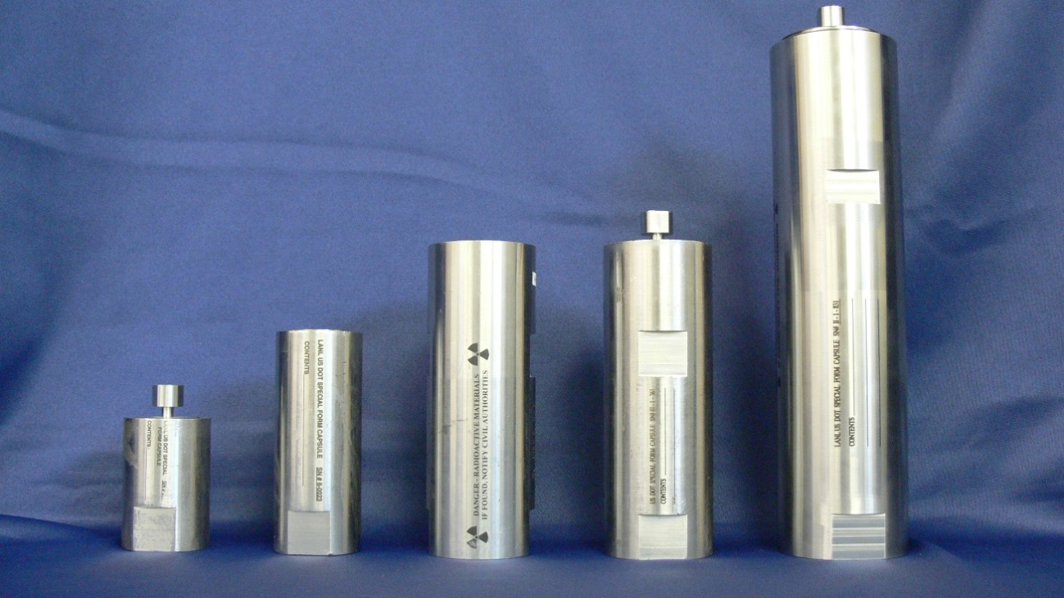
Type of SFC Models for TRU Packaging
Special Form Capsules: Model I, Model II, Model III have different internal volume and limits on source activity and weight loading

Slide 14
Self-Ship Recovery Option
Licensee packages and ships the sources to an interim staging site
Licensee must use a shipper trained to DOT requirements
Ideal option for licensees who want to expedite the removal of their sources
AK and activity under A value DOT limit requirements must be met
OSRP can provide Type A drums for self-ships

Slide 15
High Activity Beta-Gamma Source Eligibility for Recoveries
Register both excess and “in-use” sources at osrp.lanl.gov
Prioritization is based on source activity, proximity to populated areas and site security
OSRP establishes contracts with a commercial vendor for high-activity device removal
OSRP recovers an average of 15-20 high-activity beta-gamma device removals per FY

Slide 16
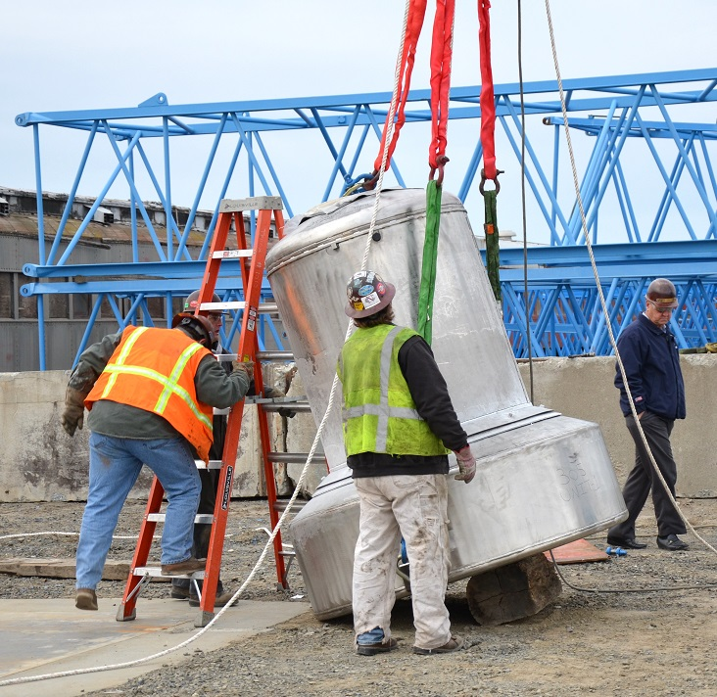
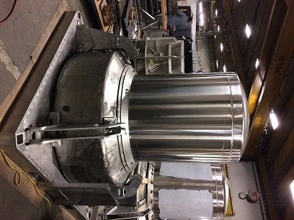
Containers for Beta-Gamma Recoveries
435B Drop Testing of Test Unit
435B Production Unit

Slide 17
Packaging and Shipment of Beta-Gamma Sources
Transportation of high-activity beta-gamma sources requires a certified Type B container
Licensed vendors or commercial companies are used to remove and prepare the devices for shipment
The self-ship option is an OSRP-assisted recovery where licensees ship the sources to a consolidation site, at which point ownership is assumed by OSRP

Slide 18
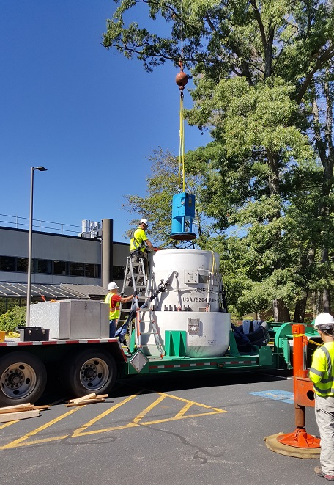
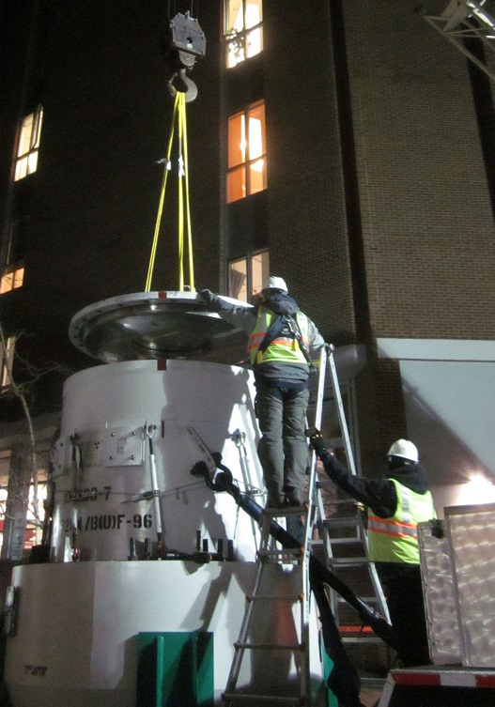
High Activity Beta-Gamma Recoveries
10-160B Container Operations

Slide 19
Type A Shipping Limits
Isotope | A₁ Limit (TBq) | A₁ Limit (Ci) | A₂ Limit (TBq) | A₂ Limit (Ci)
Pu-239 | 10 | 270 | 1E-3 | 0.027
Pu-238 | 10 | 270 | 1E-3 | 0.027
Am-241 | 10 | 270 | 1E-3 | 0.027
Co-60 | 0.4 | 11 | 0.4 | 11
Cs-137 | 2 | 54 | 0.6 | 16
Sr-90 | 0.3 | 8.1 | 0.3 | 8.1

Slide 20
Summary of Recovery Options
Source Activity < A₂ Normal Form Type A
Potential Self ship or OSRP On-Site visit
Source Activity < A₁ Special Form Type A
Potential Self ship or OSRP Site visit
A₂ > Source Activity < A₁ Normal Form Type A
OSRP On-Site visit, requires Special Form Capsule
Source Activity > A₁ Type B

Slide 21
Number of Total Recoveries and Sources Collected each FY

Slide 22
Recoveries and Sources Collected
Number of self-ships average 30 per FY, representing between 35-45% of total recoveries per year
Average number of on-site recoveries is 45 per FY
The ratio of TRU on-site recoveries to self-ships is close to 1.5:1; the high-activity beta-gamma ratio varied
There have been more total TRU recoveries than high-activity beta-gamma recoveries
The activity for beta-gamma sources recovered far exceeds that of TRU sources

Slide 23
Summary
Self-ships and on-site recoveries both help licensees to dispose of their excess sources
The compliant packaging of sources is determined by source activity, dimensions, and dose rate
OSRP has many tools to help licensees to qualify sources for recoveries: source information, qualified shippers, etc.
Many challenges lay ahead with qualifying more types of sources for disposal and resuming shipments to WIPP
The need for OSRP recoveries will continue as long as licensees use devices containing radioactive sources

Slide 24
Do you have unwanted sources?
Register sources at osrp.lanl.gov
Register unwanted sources with OSRP for recovery consideration.
Recovery is generally prioritized on the basis of activity and level of security.
Where numerous sources of lower activity are present at a single location, consideration is given to the total activity from a security perspective.
Registration of sources does not guarantee recovery by OSRP

Slide 25
Questions?
OSRP Contacts at Los Alamos National Laboratory
Becky Coel-Roback Ph: 505-667-7920 Fax: 505-665-7913 Email: becky_cr@lanl.gov
Justin Griffin Ph: 505-606-0362 Fax: 505-665-7913 Email: jgriffin@lanl.gov

