Slide 1


Pipeline and Hazardous Materials Safety Administration
Office of Hazardous Materials Enforcement
Transportation of Class 7 materials: Compliance & Regulatory issues
Thomas J. Lynch, Investigator
Field Operations, Southwest Region

Slide 2
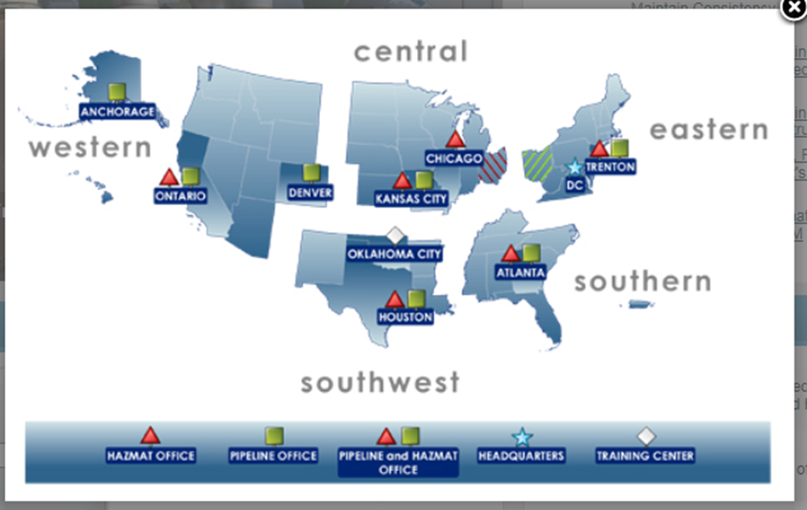
PHMSA Field Operations

Slide 3
What has PHMSA done since 1 JAN 16
Inspection numbers by Region
Central Region: 4
3 No Further Action reports
1 Ticket
Eastern Region 3
2 No Further Action reports
1 Warning letter

Slide 4
Inspection Numbers con’d
Southern Region: 15
7 No Further Action Reports
2 Warning Letters
6 Ticket
Southwest Region 53
4 No Inspections
20 No Further Action Reports
7 Warning letter
14 Tickets
8 Enforcement reports

Slide 5
Inspection Numbers con’d
Western Region: 2
2 No Further Action Reports

Slide 6
One source of information:
Reports to the National Response Center for Class 7 incidents/accidents
Year Number Reported
2007 33
2008 26
2009 27
2010 30
2011 33
2012 33
2013 27
2014 28
2015 26
2016 26
2017 6
Note: Database does not sort by class type but did a search for all “Radioactive materials”. Data is based on what is reported to the NRC. Therefore, it may not encompass the actual number of incidents, i.e., responsible party fails to report the incident.

Slide 7
Summary of noted issues
Various HM training issues & record keeping issues of such training
Various shipping paper (Declaration of Danger Goods)
Marking & Labeling issues
Failure to maintain special form documentation (testing docs or IAEA certificates)
Either no or Incomplete Type A documentation for material in package
Required USA DOT 7A, Type A package markings
Emergency response telephone (active)
Accessibility of shipping papers
Blocking & bracing

Slide 8
Noted incomplete Type A documentation since January 2017
Package evaluation criteria (178.350; subpart B of 173; 173.403, 173.410, 173.412, 173.415 and 173.465 of the HMR for Type A packages)
What is the package made of, description of all components used
What is the size, weight, and containment (package diagrams)
What Isotope(s) can I put in it
Is Special Form part of the containment
How do I close it properly; How do I know I closed it properly
Who made the package
Missing complete testing information (testing criteria, caluculations)
Shipper still required to have complete documentation for packages being used (docs kept 2-years after latest shipment)

Slide 9
Section 173.415(a)……. Until January 1, 2017 each offeror of a Specification 7A package must maintain on file for at least one year after the latest shipment, and shall provide to DOT on request, complete documentation of tests and an engineering evaluation or comparative data showing that the construction methods, packaging design, and materials of construction comply with that specification. After January 1, 2017 each offeror of a Specification 7A package must maintain on file for at least two years after the offeror's latest shipment, and shall provide to DOT on request, one of the following:
Additions to Type A packaging documentation

Slide 10
(1) A description of the package showing materials of construction, dimensions, weight, closure and closure materials (including gaskets, tape, etc.) of each item of the containment system, shielding and packing materials used in normal transportation, and the following:

Slide 11
(i) If the packaging is subjected to the physical tests of §173.465, and if applicable, §173.466, documentation of testing, including date, place of test, signature of testers, a detailed description of each test performed including equipment used, and the damage to each item of the containment system resulting from the tests, or
(ii) For any other demonstration of compliance with tests authorized in §173.461, a detailed analysis which shows that, for the contents being shipped, the package meets the pertinent design and performance requirements for a DOT 7A Type A specification package.

Slide 12
(2) If the offeror has obtained the packaging from another person who meets the definition of “packaging manufacturer” in §178.350(c) of this subchapter, a certification from the packaging manufacturer that the package meets all the requirements of §178.350 for the radioactive contents presented for transport and a copy of documents maintained by the packaging manufacturer that meet the requirements of paragraph (a)(1) of this section.

Slide 13
In Summary
The offeror (still) must maintain complete Type A package documentation for at least two years from latest shipment
If tests were performed, added information must be part of the documentation
Getting a certification from the package manufacture is permissive but offeror must still have complete documentation (with new additions)

Slide 14
Contact Information
Thomas J. Lynch
Investigator, Southwest Region
Field Operations
Email: tom.lynch@dot.gov
Phone: 713-272-2820
Notes:
Note: Subpart D Enforcement, Section 107.305 Investigations (a) General only states that The AA encourages voluntary production of documents in accordance with and subject to 105.45….. So no specific time line to comply with request is written here ( may be further up the rules/code

Slide 15
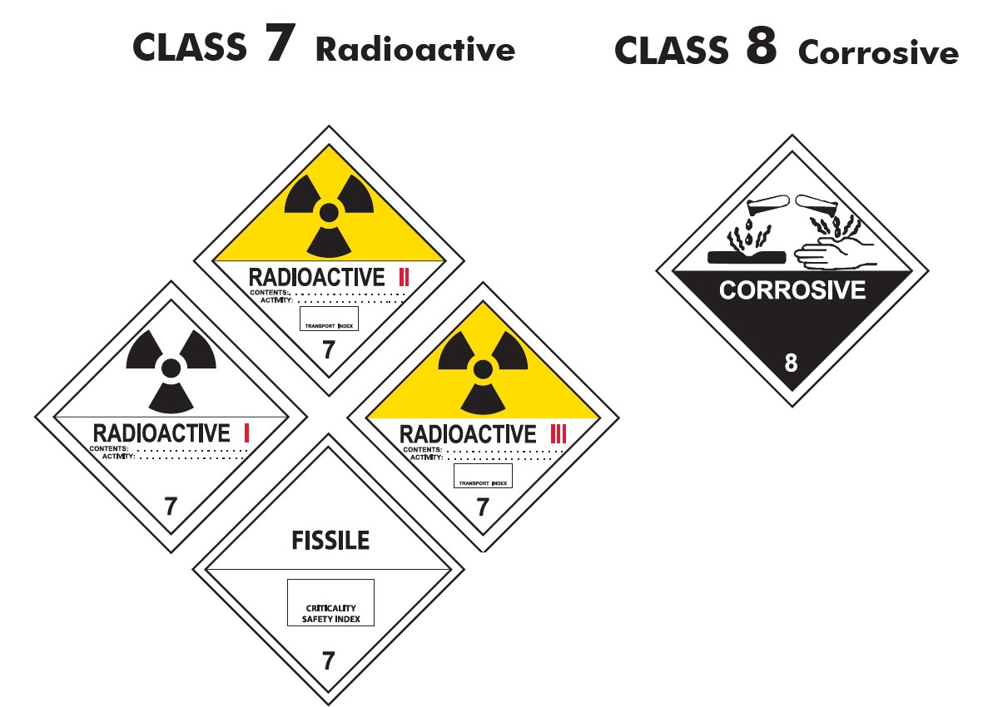
QUESTIONS ?
Notes:
I have a question: PHMSA has over the years done reviews to “update and remove old regulations that make no sence”, the President has asked all government Agencies to look at theior Rules and regulations and to remove and/ or update regulation that no longer support a safety function or not needed. Please email your suggestion with comments and justification for your suggestion so I may forward to the PHMSA committee working this Presidential imitative.

