Slide 1
DOE O 460.1D
Changes and Implementation Plan
Ashok Kapoor, Safety Engineer (DOE-OPT)
Chad E. Thompson, Package Certification Engineer (NNSA-OPT)
Packaging Management Council Meeting
Point Clear, AL, May 23, 2017
End
Notes:
Before I get into the nitty gritty of talk, I would like to talk about my office mission and what we all do to assist sites to maintain safe and secured HAZMAT transportation system including nuclear materials.
Our mission is to provide guidance, tools, and support for DOE programs and contractors in order to assure safe, compliant, reliable, and efficient transportation of the Department's hazardous and nonhazardous materials.

Slide 2
Overview
Order Background
Order Outline
Order Development
Registration and QAP Process Matrix
Items under consideration
Impact of changes to DOE O 460.1D
Comment Resolution
Responsibilities
Path Forward
Notes:
Focus of my talk is on requirements and implementation responsibilities of CO, Field Office Manager and Contractor

Slide 3
Order 460.1D Background
The DOE Office of Packaging and Transportation (OPT) is the Department’s Office of Principal Interest (OPI) for DOE O 460.1D, “Hazardous Materials Packaging and Transportation Safety” published on 12-20-2016.
Basis for revision of old Order 460.1C, dated 05-10-2010:
Need to clarify requirements, roles and responsibilities
Need for realignment between two DOE Orders O 460.1C, and O 461.1B owned by NNSA
Feedback from DOE/NNSA sites on implementation issues related to these two Orders-PMC webinar, February, 2014
Need for consistent guidance and direction to sites in the implementation of these safety Orders

Slide 4
Order 460.1D Outline
DOE O 460.1D, “Hazardous Materials Packaging and Transportation Safety” consists of the following sections:
PURPOSE
CANCELLATION
APPLICABILITY
REQUIREMENTS
RESPONSIBILITY
REFERENCES
DEFINITIONS-Attachment 2
ACRONYMS-Attachment 3
CONTACT
Attachment 1- CONTRACTOR REQUIREMENTS DOCUMENT
Notes:
This presentation is focused on QA requirements and changes from Old Order 460.1C

Slide 5
Order Development
DRB approved JM on January 15, 2015 and 180-day clock started:
Team-1 developed the draft Order 460.1D and submitted to MA on 4/15, 2015 and RevCom comment period was closed on 5/30
Team-1 resolved 400 comments and submitted draft Order to DRB on 9/30, 2015 but OPT withdrew it in November 2016
OPT assigned Team-2 to develop draft Order that was posted on Revcom for comments on May 10, 2016
OPT withdrew Team-2 draft from RevCom in June 2016 and assigned Team-3 to develop draft Order
Team-3 posted revised draft (slightly modified Team-1 draft) on RevCom for 2nd round of comments in June 2016
Team-3 resolved another 300 comments and DRB approved the final draft Order in December 2016

Slide 6
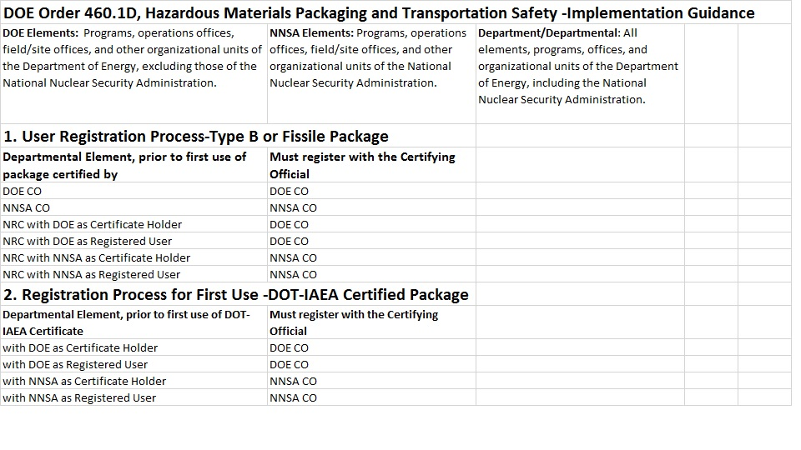
Registration and QAP Process Matrix
Notes:
This presentation is focused on QA requirements and changes from Old Order 460.1C

Slide 7
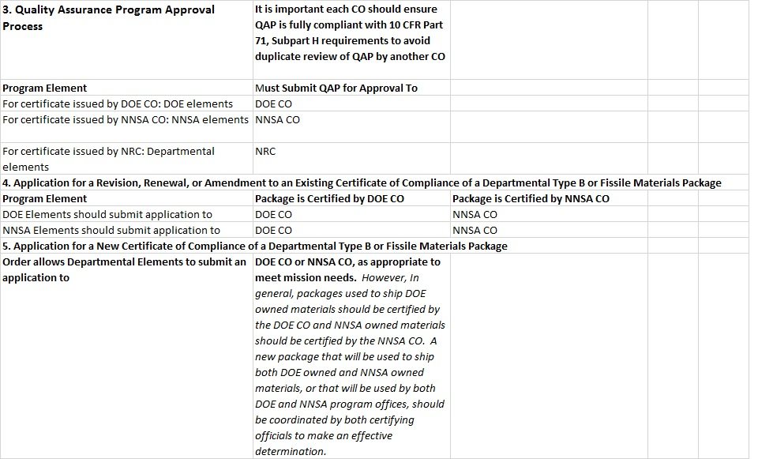
Registration and QAP Process Matrix (cont.)
NOTE: Each Certifying Official shall review an applicant SARP in accordance with NRC requirements and guidance to prevent CO shopping by an applicant.
Notes:
This presentation is focused on QA requirements and changes from Old Order 460.1C

Slide 8
Impact of Changes to DOE O 460.1D and Comment Resolution
Table Overview:
Revised Section
Description of Change
Type of Change (Minor or Significant)
Related Question/Concern submitted by sites
Section Clarification/Question Response
Word Table

Slide 9
Path Forward
Finalize answers to Frequently Asked Questions
Resolve items under consideration
Host a joint DOE/NNSA webinar to go over the Order changes and Implementation Plan with sites

Slide 10
Need more packaging information?
ASKPAT@HQ.DOE.GOV
Contact List for Order Issues :
Joanne Lorence, DOE Director and DOE CO, (202) 586-2433
Ashok Kapoor, Packaging Safety Engineer, (202) 586-8307
James Shuler, PCP Manager, (301) 903-5513
Kathy Schwendenman, NNSA Director (505) 845-4185
Ahmad Al-Daouk, NNSA CO (505) 845-4607
Noey Brewer, Package Certification Engineer (505) 845-5768

Slide 11
Backup Slide

Slide 12
Items under consideration
Container name plates
NNSA CoC Certificate layout
NNSA Quality Assurance Plan expiration
Others

