Slide 1

Global Dangerous Goods Expansion
2017 CTMA
May 25, 2017

Slide 2




A history of change
Founded 1907

Slide 3
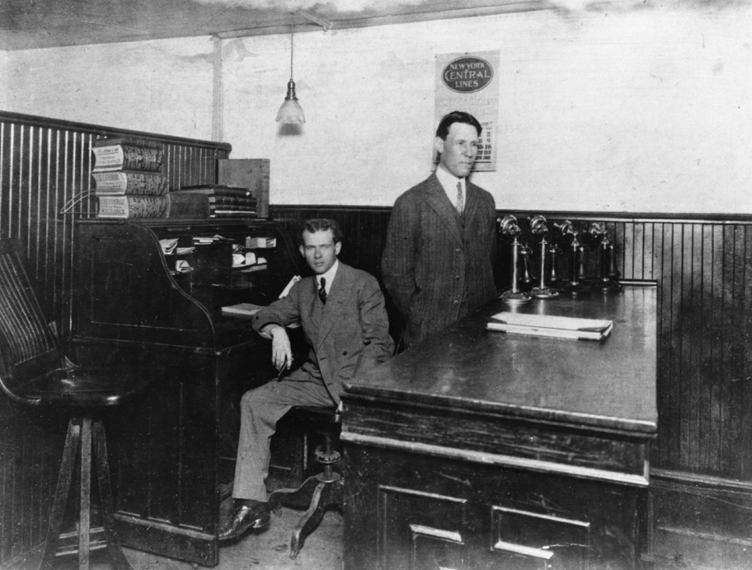
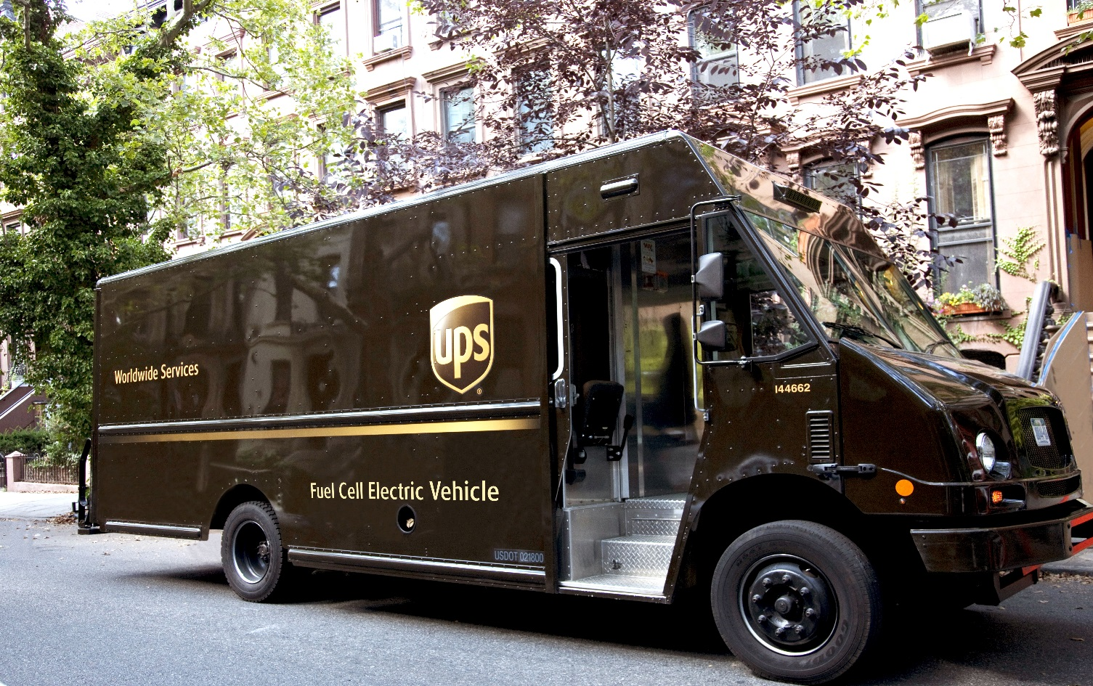
A spirit of innovation
U.S. DOE and UPS

Slide 4

A culture of ethics
11th consecutive year

Slide 5

2017 Global Dangerous Goods Service Expansion
April 2017
  UPS now accepts Cargo Aircraft Only (CAO) shipments
  CAO offering expands our accepted quantities (1,206 commodities)
  Single Packaging accepted in our CAO service
  CAO is a contracted service

Slide 6




2017 Global Dangerous Goods Service Expansion
  Expanded Acceptable Commodities
    UPS chemical table expanded adding over 300 commodities previously not accepted
  Removed Special Permit requirement for U.S. shipments of Class 6.1 PG III

Slide 7
2017 Global Dangerous Goods Service Expansion
  Expanded to fully regulated ADR ground shipment in Europe
    Adding over 1,800 commodities to our ground ADR service
    Expansion now allows greater service to and from Europe
      Example Section I and Section IA Lithium battery shipments

Slide 8
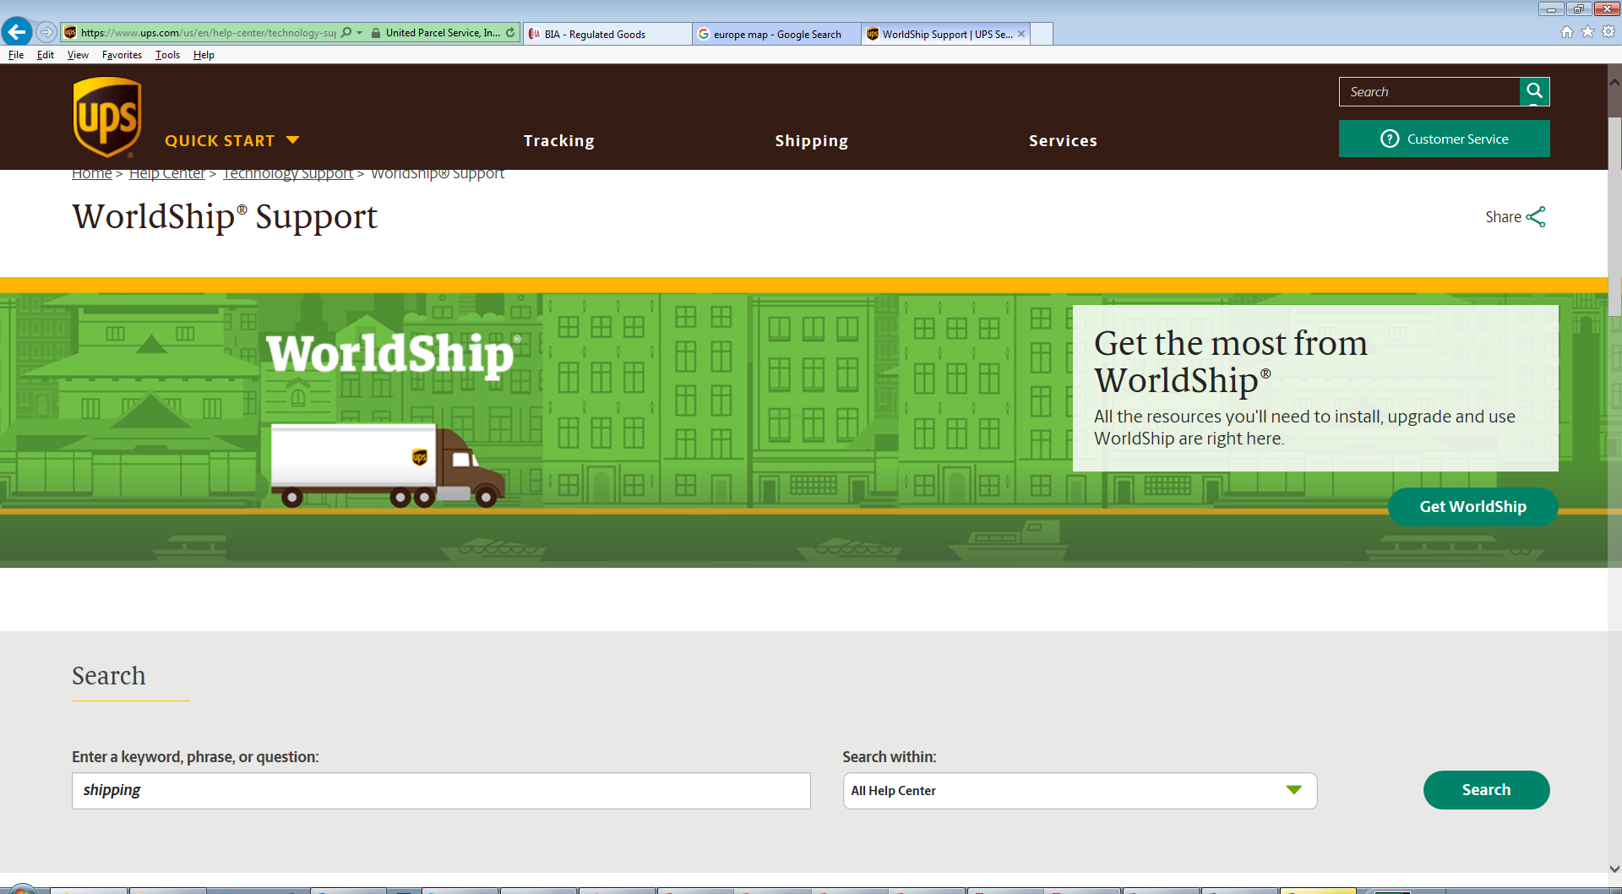
2017 Global Dangerous Goods Service Expansion
  UPS WorldShip 2017
    Enhanced dangerous goods functionality
      Validation of DG detail to reduce errors and avoid rejected shipments
      Pre-alert notification to UPS to expedite processing and avoid delays
      Host or vendor systems? UPS provides Dangerous Goods API’s for developers

Slide 9
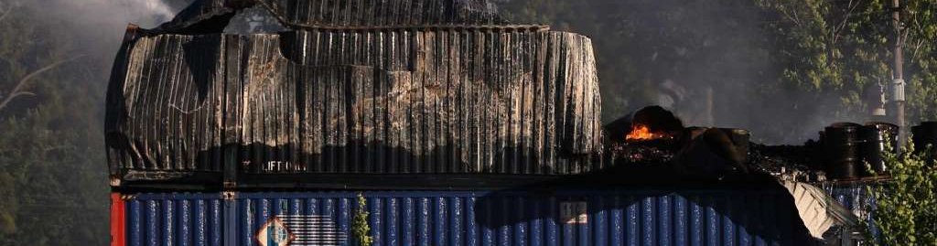
Looking to the Future
UPS continues to evaluate expansion opportunities
Examples of dynamic regulatory environment
  DOT PHMSA presentation April 2017
  Lithium batteries

Slide 10
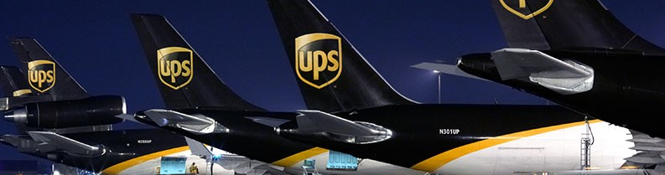
Global Dangerous Goods Expansion
Thank you

