Slide 1
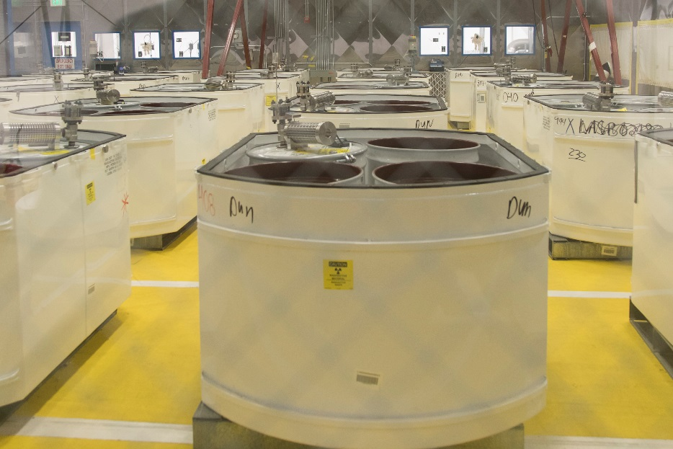
Remediated Nitrate Salt (RNS)
Remediation and
Other WIPP Activities
Steven B. Fellows
LANL

Slide 2
RNS Stabilization
RNS Drum led to February 14, 2014 WIPP Incident
  Un-remediated Nitrate Salts from Legacy Nitric Acid Distillation Process processed for WIPP - remove free liquids
  Mixture of Oxidizer (D001) with Wheat Based Organic Absorbent
  Lowered Initiation Temperature for event
RNS Drums at LANL Require Remediation
Additional Drums Stored at Waste Control Specialists Low-Level Waste Facility in Texas – Transportation or Remediation Path out of facility not resolved at this time
LANL RNS Drums are Currently in Safe Storage – Temperature Control and Higher Flow Drum Filter with Rupture Disk (PRDwSF)

Slide 3
Cause
an exothermic reaction of incompatible materials that led to thermal runaway, which resulted in over-pressurization of the drum, breach of the drum, and release of a portion of the drum’s contents (combustible gases, waste, and wheat-based absorbent).
Isotopic ratios in air sample media analyzed post-event are which is unique from other drums in the area of the release.
Included incompatible materials which created the potential for an exothermic reaction.
the only waste container with an identified breach.

Slide 5
Evidence – Out of the Report
The visual evidence associated with the identified breach was consistent with an exothermic reaction. This reaction resulted in internal heating of the drum that led to internal pressure buildup of combustible gases within the drum which exceeded the drum venting capacity. The drum lid extruded beyond the lid retention ring, deflected the lid, and resulted in rapid release of the materials from the drum. The combustible gases and solids ignited which then spread to other combustible materials within the waste array, i.e., fiberboard and polyethylene slip sheets, reinforcement plates, stretch wrap, cardboard stiffeners and polypropylene super sack fabric.

Slide 6
RNS Drums with Filter Assembly

Slide 7
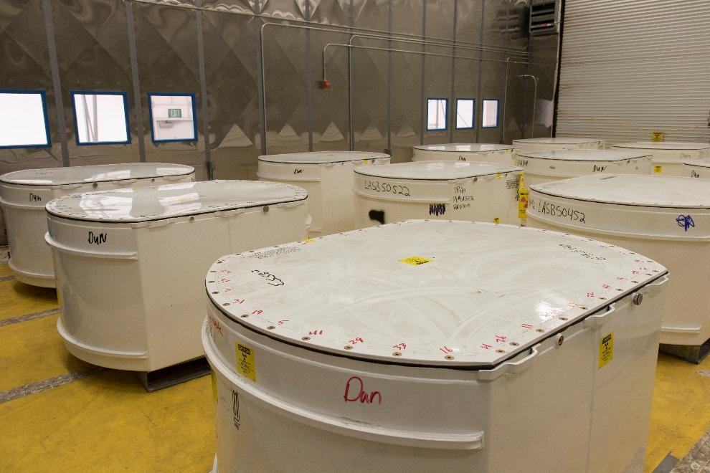
RNS Stabilization Activities
Cool Drums at Current TA-54 Storage Location
Transfer Drums to Waste Characterization, Reduction and Repackaging Facility (WCCR) – 3.2 miles
At WCCR Mix with Zeolite to Remove D001 and free liquids, Package for Disposal at WIPP
Transfer Stabilized Material Back to TA-54

Slide 8
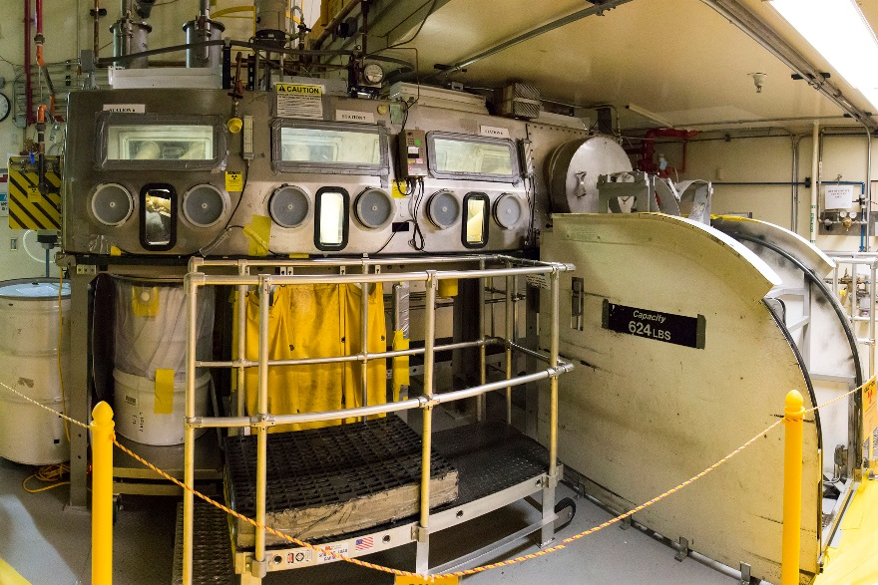
WCCR

Slide 9
RNS Transportation to WCCRF
RNS Control Changes
  Controls Added
    Verification of Cooling Prior to Transfer
    Use of Thermal Cooling Jacket
    PRDwSF is Secured to the Drum
    12-hour Maximum Allowable Transfer Time
  Controls Modified
    Container has PRDwSF (Removes Type A Performance)
    Restricted Public Access via Road Closure
    Reduced Nuclear Material Limit
    Enhanced Road Condition Restrictions
    Reduced Transport Vehicle Speed
Administrative and Safety Management Program Controls unchanged

Slide 10
RNS Stabilization Preparation Activities
Safety Basis Completed
Procedures and Training Complete
Readiness Assessments Complete
Waiting WIPP and DOE Hq Approvals
Began moving Drums to WCCR Last Week

Slide 11
Status of Other WIPP Shipments
Preparing to Resume WIPP Shipments
  LANL Radioassay And Nondestructive Testing Facility Down (RANT) down – seismic concerns
  TRUPACT-II Mobile Loading Equipment and Processes Coming in
    CCP to Perform the Mobile Loading with Support from LANL
  Readiness Activities Starting in Late May - June 2017
  Have a number of Authorized Drums ready to ship in July
  Follow up with more shipments in the September – October timeframe.

