Slide 1
When US DOT Leaves
Notice of Claim SC-2017-0005-US1377
Lessons Learned
Teri Davis, Motor Carrier Compliance
Savannah River Site / Savannah River Nuclear Solutions, LLC
CTMA
May 2017
Point Clear, AL

Slide 2
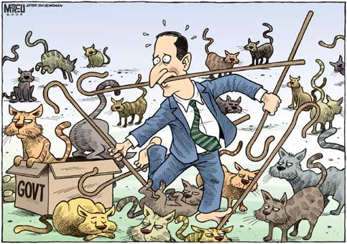
FMCSA HM Compliance Investigation Oct 24-27, 2016
Before DOT comes to call
Relax
DOT

Slide 3
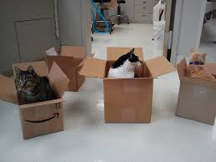
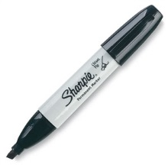
FMCSA HM Compliance Investigation Oct 24-27, 2016
You got this!
DQ
D/A
HOS
CMVs

Slide 4
FMCSA HM Compliance Investigation Oct 24-27, 2016
Have Ticklers for
Permits and Registrations
Transportation Security Plan*
Updates to Drug & Alcohol policy and other procedures
Checking up on Drug and Alcohol test numbers at least quarterly *
Match up HM Shipping papers with your HOS*
Obtain MVRs for each renewed Medical Certificate* AND check the DMV for errors!

Slide 5
FMCSA HM Compliance Investigation Oct 24-27, 2016
Management may “assume” RISK
just remember who will be jumping through the hoops…

Slide 6
FMCSA HM Compliance Investigation Oct 24-27, 2016
DOT vs DOE
Do not eschew US DOT numbers with DOE required “DOT” numbers
Onsite only vehicles
Onsite only drivers
Utilize the TSD for FMCSA
TSP
Comm Plan

Slide 7
FMCSA HM Compliance Investigation Oct 24-27, 2016
Do not assume you have to pay what they are asking!
40% reduction

Slide 8
FMCSA HM Compliance Investigation Oct 24-27, 2016
NEVER GIVE IN

