Slide 1
“Moving 101” A Macro-to-Micro View of
the Van Line Industry…
Presented by
Mark Colo, CRP, REB
V.P of Sales Chipman Relocation
& Logistics
^{Thursday, May 25th, 2017}

Slide 2
“Macro View”
Neanderthal Moving & Storage - Van Line Beginnings
The early 1800’s to late 1900’s moving explosion.
Trends in Moving & Storage
The Oligopoly Game of Chess. Win or Lose?
Govt. & Private Institutional Influencers
The Future Landscape of the Van Line Industry.

Slide 3
“Micro View”
The Two Primary Service Models – Multiple Agent and Self Pack & Haul.
Guidelines for carrier selection.
Moving Trivia.
Future Trends in Moving & Storage.
Closing Remarks.

Slide 4
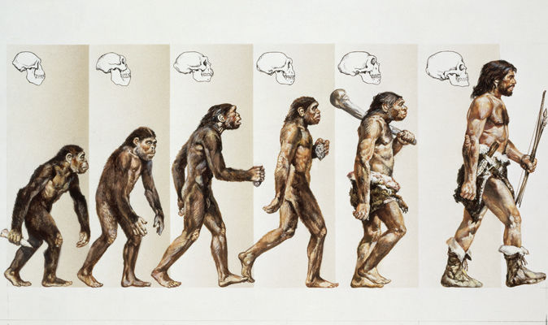
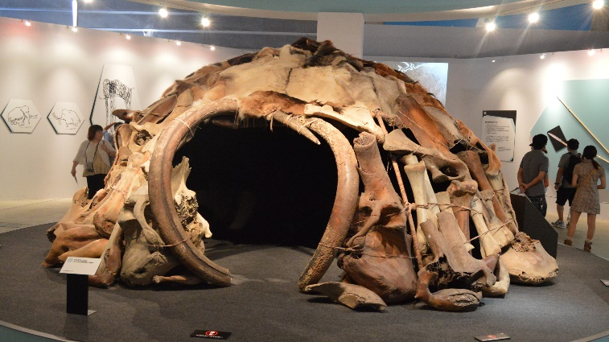
“Neanderthal Moving and Storage”
Moving & Storage began about 250,000 years ago
Neanderthal Man
Sedentary Lifestyle
Cave Dwelling
Was the Standard
Wooly Mammoths were hard to take down and tough to chew
Global Warming Accelerated Migration
Affordable & Portable Housing
& Mobility became
“The Norm”
Communal living and hunting became the Standard
Evolution – Introduced
Migratory Living

Slide 5
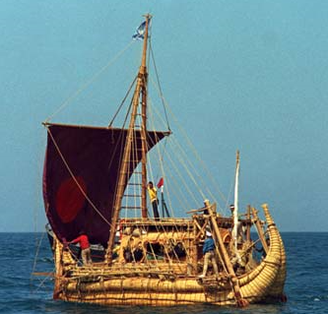
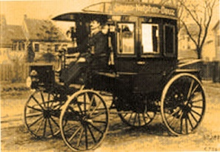
1800’s – 1900’’s “Manifest Destiny”
Before Planes, Trains and Automobiles
Moving & Storage exploded
In 1895 Karl Benz built the first truck using the internal combustion engine.
Boats were the
moving standard
1947 - Thor Heyerdahl Proved Continental Crossings were Possible. He sailed from
Peru to Tahiti

Slide 6
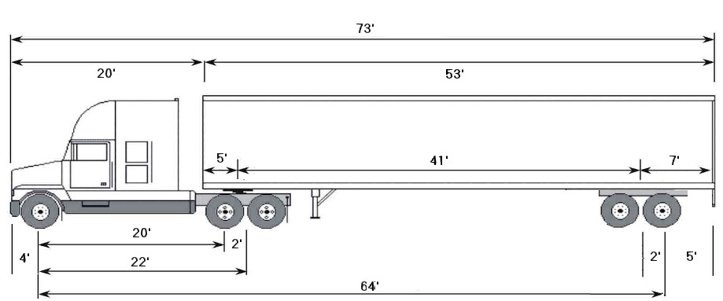
One year following the introduction of the internal combustion engine, Alexander Winton needed a better method for delivering the cars he was manufacturing.
Engine six times bigger than the average car engine and extended up to 800,000 more miles than cars. It would reach a combined length of 75 - 80 feet.
A Gross Weight of 80,000 lbs., with a Cargo Capacity of about 45,000 lbs. And a household goods capacity of about 30,000 lbs.
Kenworth
Peterbilt
Volvo
2 Wheels in Front & 16 wheels under the trailer.
Semi-Tractor Trailer Units transport around 70% of all commodities in the United States.

Slide 7
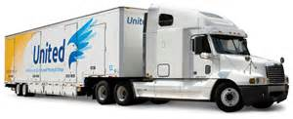
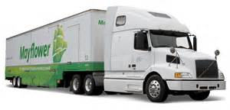
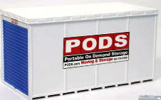
“The Players” in Moving & Storage”
Van Line Headquarters are based primarily in the “Eastern Half” of the U.S.
Owner Operators
are Retiring/Leaving
A recent shift from 3 - 4 Tier Policies + New Hire/ Mgt./Exec./D.I.Y. U-pack-Load

Slide 8
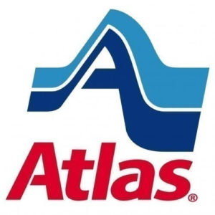
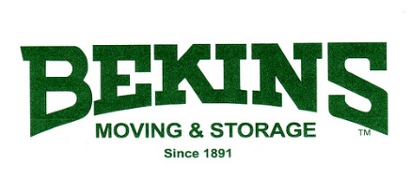
“Oligopoly Leaders” The Game of Chess
These were the dominant players the past 30 yrs.
Oligopoly is derived from the Greek word Oligos meaning few and Polein meaning 'to sell'. A condition in which a market or industry is dominated by a small number of sellers, referred to as “Oligopolies”.
Win or Lose…
It’s About How You Play the Game.

Slide 9
Government and Private Institutions Influencing the Moving & Storage Industry
The Past 100 Yrs. at a Glance
1920: The National Furniture Warehousemen's Association (N.F.W.A.) was established and became the oldest trade association for movers.
1936: The Household Goods Carriers' Bureau (H.G.C.B.) was established to assist motor carriers in complying with interstate regulations.
1962: The HGCB changed its name to the American Movers Conference (A.M.C.).
1980: Deregulation introduced a free market system / raising the bar on quality and innovation.
1982: The NFWA changed its name to the National Moving & Storage Association (NMSA).
1998: NMSA, AMC & HGCB merged to become the American Moving & Storage Association (A.M.S.A.) Today’s largest trade association for moving & storage, Today it has 4000+ members.
1964: The Employee Relocation Council (E.R.C.), now based in Washington DC is the largest networking and educational forum in the country for all aspects of relocation.
2012: BAMM – Bay Area Mobility Managers, formerly Bay Area Professionals in Relocation Management (BAPRM) is the second largest networking and educational forum in the nation for relocation.

Slide 10
Evolution has occurred in some areas
Van Lines have made progress in the past 20-yrs, in these areas...
Cloud based software - for immediate data transfer and paperless documentation.
Wireless I-Pads and printers - have become the standard for estimating and presentations in the home. Wireless technology can send the estimate to the move coordinator at the same time it is made available to the transferee.
Software and Apps - have been developed that may soon eliminate the traditional duties of a residential salesperson, thereby reducing costs and protecting the environment.
Online Portals and E-signatures - to process Claims and other Control Documents.
Just-In-Time (J.I.T.) information - providing valuable instructions when needed most. i.e. 1) The Move Coordinators Role 2) Pack Day Instructions 3) Load Day Instructions 4) In Transit Updates 5) Delivery Day Instructions 6) Claims procedures.

Slide 11
Despite the progress made, our industry is still primitive in many areas.
Behind UPS & FedEx “Paperless Processes & Automation”.
Move Documentation in files are still one-inch thick.
Documents in many Instances are still Illegibly hand written.
We still use sticks to leverage heavy Items.
Bar Coding is still a prison term to many movers.
Technological advancements have been slow to materialize.
Areas for improvement Include:
Agency Relations
Apps
Claims
Communications
Diversification
Documentation
Material Content
Monitoring
Green Initiatives
Operational Efficiencies
Quality Improvement
Rewards & Recognition

Slide 12
Multiple Agent (Franchise) Model
The Van Line
Booking Agent
(B.A.)
Directs the Move
Origin Agent
(O.A.)
Survey/Estimate & Packing
Hauling Agent
(H.A.)
Transports the Goods
Destination Agent (D.A.)
Stores the Goods
Revenue Split
5%
10 %
15%
20%
50%
Franchise Agent
1
2
3
4
1. How many different agents does it take to service a long/D. move? It depends. 2. How many agents does it take to service a local move? Just one.

Slide 13
“Self Pack & Haul Model”
Self Pack/Haul/Deliver Service Model
Driver Team Assigned to Pack & Load Shipment
Same Team Transports the Shipment
Same Team Unloads and Unpacks the Shipment
Pro’s
Fewer Moving Parts
Single Accountability
Faster Billing & Problem Resolution
Faster Communication
Con’s
Agents Lose Packing Revenue
Less Revenue, Less Incentive to Help
Fewer Check’s & Balance’s
Could Cost you More

Slide 14
“10 Guidelines for Choosing a Mover”
According to A.M.S.A. about 88% of all agents have five or less employees.
Ask for References?
What’s their Business Mix?
Are they a Franchisee or an Independent Van Line?
Are they Asset Based (or) do they Broker their business?
Do they have Local, Regional or National Coverage?
Are they Financially Stable? Revenue Growth? Are they Profitable?
How large are their Network Resources?
How long have they been In Business?
Do they have any Unique Services?
Are they Family Owned? If so, Are the Owners Engaged in the Business?

Slide 15
Moving Trivia; “Did you Know?”
You have 10 seconds per question
How much weight will those big trailers hold?
Ballpark estimates are for budgetary purposes only. What’ s the best way to get a quick estimate of cost?
Metrics that help in auditing your invoice. Follow “Route 66” – There are 6 primary documents and 6 steps to follow in your audit. What are they?
How do you estimate the pack and load crew size? How many hours will the packing and loading take?
How can you determine the weight of goods in storage without paperwork? (Important since the highest charges are weight based.)
According to AMSA statistics 87% of all van line agents employ:
A) 20 employees or less, B) 15 employees or less, C) 10 employees or less
D) 5 employees or less

Slide 16
“Future Trends”
Evolution Will Continue and Migration Will Increase
Mergers and Acquisitions will increase.
Lump Sum Payments will Increase, as will D.I.Y. (Do-It-Yourself) Moves. The Moving Industry will adapt itself to support Mellinnial needs.
The Use of Intermodal & Containerized shipping will increase.
The size of household goods shipments will continue to shrink, as retiring Boomers downsize and Millennials flood the marketplace.
The need for household goods training will increase, as industry veterans retire and H.R. continues it’s downsizing trend, leaving newbee’s to manage what may appear to be a foreign language and process.
Household Goods Moving 101 will continue to evade the accredited class category at your local university and remaining a “trial & error” learn it on the job proposition.

Slide 17
“Closing Remarks”
“The New Millennium in Moving & Storage will be ruled by Millennial’s”
“Never look back unless you are planning to go that way.” – Henry David Thoreau
My Three Credo's in Life Are:
“The Only Constant, is Change”, Embrace It.
“If You Think Things Can’t Get Worse, You’re Wrong”, Accept It.
“Control Is An Illusion”, Let Go Of It”.
I’ll close with a brief satirical video that showcases tomorrows emerging class of transferee known as the Millennial.
It’s entitled;
“Gotta Love Millennials.”

Slide 18
“Thank You for Your Participation”
Is This Your Daughter?

